Slide 1
CS161 Discussion 2 Uninformed Search Algorithms
Original credit to: Jinghao Zhao, 10/16/2020
Modified by: Sidi Lu, 10/08/2021

Slide 2
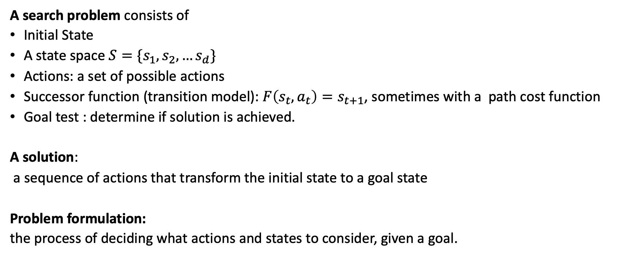
Search Problem
A search problem consists of
Initial State
A state space$S=\{s_{1},s_{2},…s_{d}\}$
Actions: a set of possible actions
Successor function (transition model): $F\left(s_{t}, a_{t}\right)=s_{t+1}$, sometimes with a path cost function
Goal test : determine if solution is achieved.
A solution:
a sequence of actions that transform the initial state to a goal state
Problem formulation:
the process of deciding what actions and states to consider, given a goal.
Notes:
Problem formulation is the process of deciding what actions and states to consider, given a goal.

Slide 3

Search Problem – Example - Travel from CA to MA
Initial State: CA
State space: 50 states in U.S.
Actions: go to adjacent state. cost=distance
For example, Actions(CA)= {Go(OR), Go(AZ), Go(Nevada)}
Successor function (transition model)
RESULT(In(CA), Go(AZ)) = In(AZ)
Goal test:
state == MA?
Path cost function

Slide 4
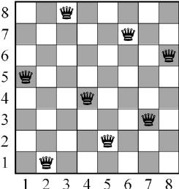
Search Problem – 8 queens
Objective:
Place eight queens on a chessboard such that no queen attacks any other.
(No two queens on the same row, column, diagonal)
(We don't care about how or how long you find the solution)

Slide 5
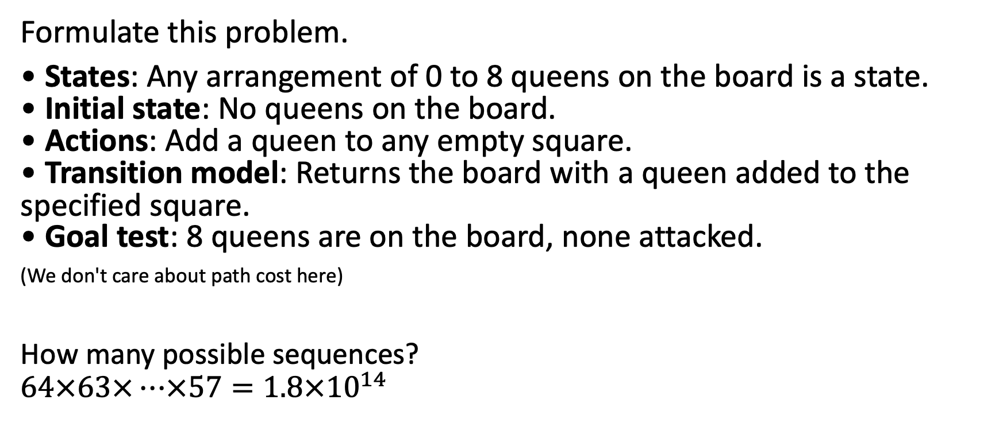
Search Problem – 8 queens
Formulate this problem.
• States: Any arrangement of 0 to 8 queens on the board is a state. • Initial state: No queens on the board. • Actions: Add a queen to any empty square. • Transition model: Returns the board with a queen added to the specified square. • Goal test: 8 queens are on the board, none attacked.
(We don't care about path cost here)
How many possible sequences?
$$64×63×…×57=1.8×{10}^{14}$$
Notes:
This is called incremental formulation. we start with an empty state. each action adds a queen

Slide 6
Search Problem – 8 queens
States: All possible arrangements of n queens (0 ≤ n ≤ 8), one per column in the leftmost n columns, with no queen attacking another.
Actions: Add a queen to any square in the leftmost empty column such that it is not attacked by any other queen.
Transition model: Returns the board with a queen added to the specified square.
Goal test: 8 queens are on the board, none attacked.

Slide 7
Search Problem – 8 queens
Incremental formulation
Start with an empty state
Each action adds a queen
Complete-state formulation
Start with all 8 queens on the board
Moves queens around
In either case, path cost doesn't matter because only final state counts.

Slide 8
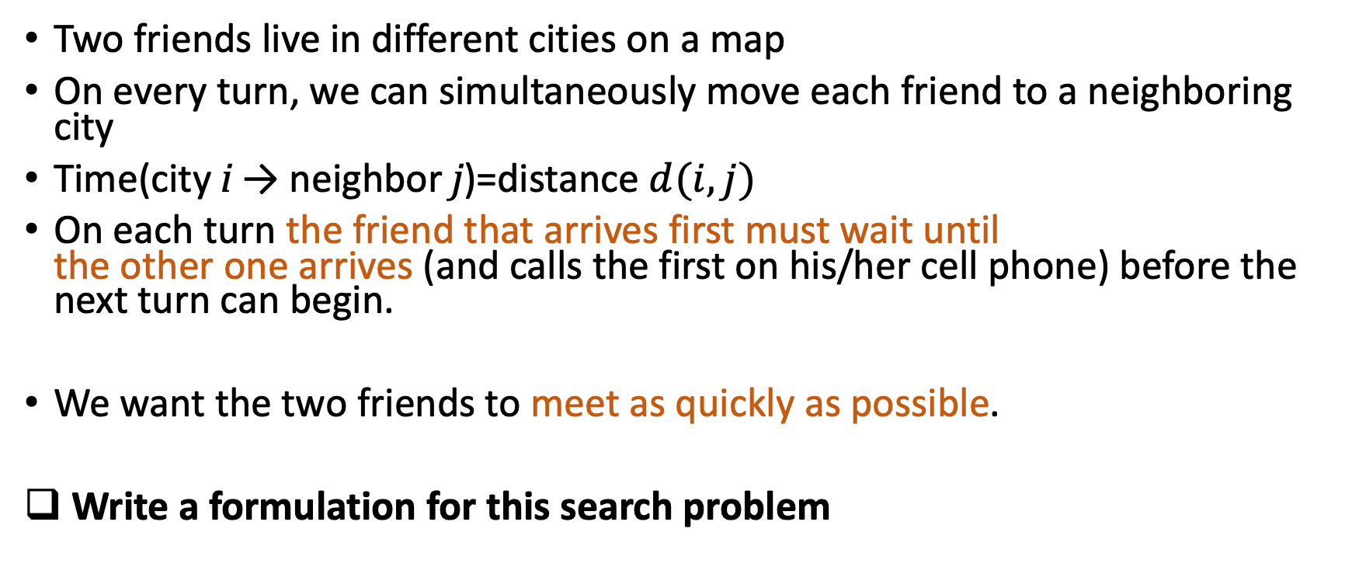
Search Problem Formulation - Exercise 1
Two friends live in different cities on a map
On every turn, we can simultaneously move each friend to a neighboring city
Time(city i → neighbor j)=distance $d(i,j)$
On each turn the friend that arrives first must wait until the other one arrives (and calls the first on his/her cell phone) before the next turn can begin.
We want the two friends to meet as quickly as possible.
Write a formulation for this search problem
Notes:
States: where they are
Initial state: A at i, B at j
Actions: A/B moves to an adjacent state
Action(i) = {GOTO(i), if i and j are adjacent)
Transition model: Results( (A in i), (B in j), A goto k, B goto m)) = (A in i), (B in j)

Slide 9
Search Problem Formulation – Exercise 2
3 missionaries and 3 cannibals are on one side of a river
A boat can hold one or two people.
NOT allowed (on either side): # of cannibals > # of missionaries
Find a way to get everyone to the other side
Write a formulation for this search problem
Notes:
This problem is famous in AI because it was the subject of the first paper that approached problem formulation from an analytical viewpoint (Amarel, 1968).

Slide 10
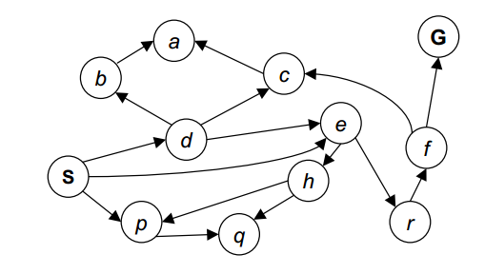
State space graph
Nodes are (abstracted) world configurations
Arcs represent successors (action results)
Goal test: one or a set of goal nodes
Each state occurs only once!

Slide 11
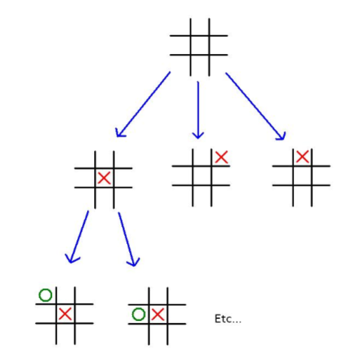
Search Tree
A "what if" tree of plans and their outcomes
Root: initial state
Children: correspond to successors

Slide 12
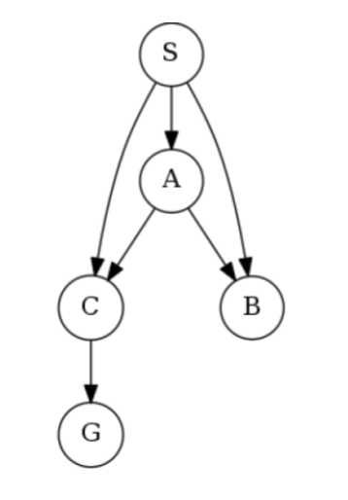
Quiz
How many nodes are there in this search tree?
Notes:
s -> (a,b,c), c->g
a->(b,c), c->g
8 nodes

Slide 13
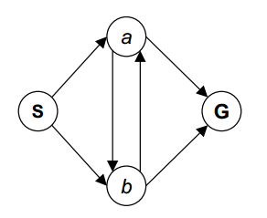
State Space Graph vs Search Tree
4-state graph
How big is the search tree?
Notes:
Lots of repeated structure

Slide 14
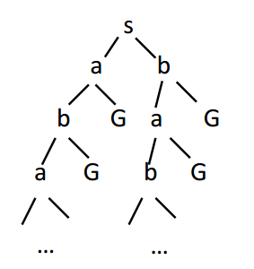

State Space Graph vs Search Tree
$$∞$$
4-state graph
How big is the search tree?
Notes:
Lots of repeated structure

Slide 15
State Space Graph vs Search Tree
$$∞$$
4-state graph
How big is the search tree?
Expand out potential tree nodes
Maintain a fringe of partial plans under consideration
Try to expand as few tree nodes as possible
Notes:
Lots of repeated structure

Slide 16
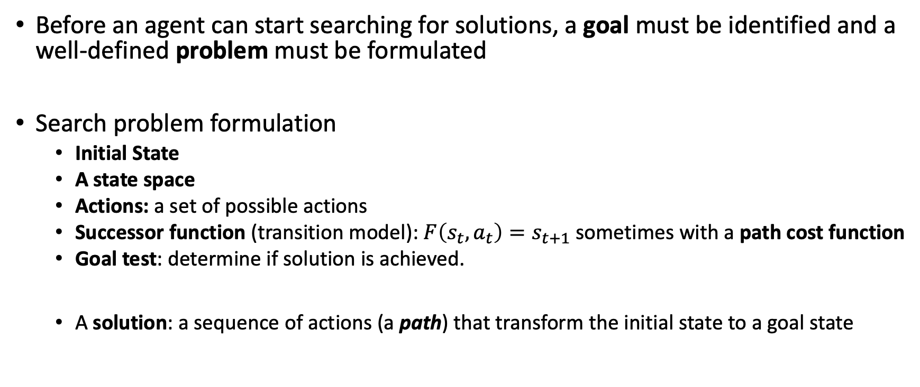
Search Problem
Before an agent can start searching for solutions, a goal must be identified and a well-defined problem must be formulated
Search problem formulation
Initial State
A state space
Actions: a set of possible actions
Successor function (transition model): $F\left(s_{t}, a_{t}\right)=s_{t+1}$sometimes with a path cost function
Goal test: determine if solution is achieved.
A solution: a sequence of actions (a path) that transform the initial state to a goal state

Slide 17
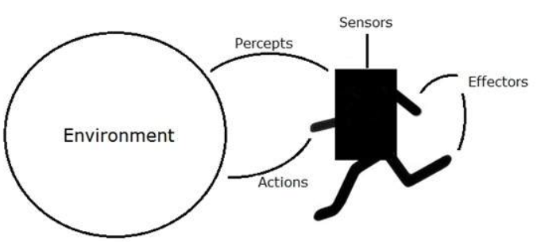
Agents
An agent perceives its environment through sensors and acts upon it through actuators

Slide 18
Agents
Rational agents:
Choose actions that maximize the expected utility
Example 1: have a goal and a cost
Reach the goal with the lowest cost
Example 2: have numerical utilities, rewards, etc.
Take actions that maximize total reward over time
Reinforcement learning

Slide 19
How to evaluate search algorithms
completeness
optimality
time complexity
space complexity
Notes:
Search algorithms are judged on the basis of completeness, optimality, time complexity, and space complexity.

Slide 20
Key concepts
Frontier (nodes to expand)
Generation: A node 𝑛 is generated when a data structure representing its contents is created, i.e., when it is allocated in main memory.
Expansion: A node 𝑛 is expanded when all its children are generated.
Notes:
?

Slide 21
Uninformed Search
BFS
DFS, Depth-Limited Search
Iterative Deepening
Uniform-cost search

Slide 22
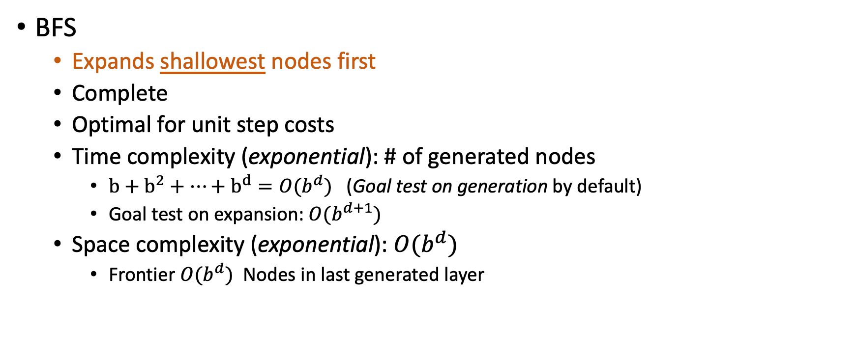
BFS
BFS
Expands shallowest nodes first
Complete
Optimal for unit step costs
Time complexity (exponential): # of generated nodes
$b+b^{2}+…+b^{d}=O(b^{d})$ (Goal test on generation by default)
Goal test on expansion: $O(b^{d+1})$
Space complexity (exponential): $O(b^{d})$
Frontier $O(b^{d})$ Nodes in last generated layer
Notes:
BFS: Both time and space: On expand: O( b^d), On generate O(b^(d+1))
b+b^2+...b^d = O(b^d)
等比数列求和公式 Geometric progression official
a1+a1q+... (n items) = a(1-q^n)/(1-q)
Uniform-cost search
Dijikstra
Fringe (frontier): nodes to expand
If you're performing a tree (or graph) search, then the set of all nodes at the end of all visited paths is called the fringe, frontier or border.

Slide 23
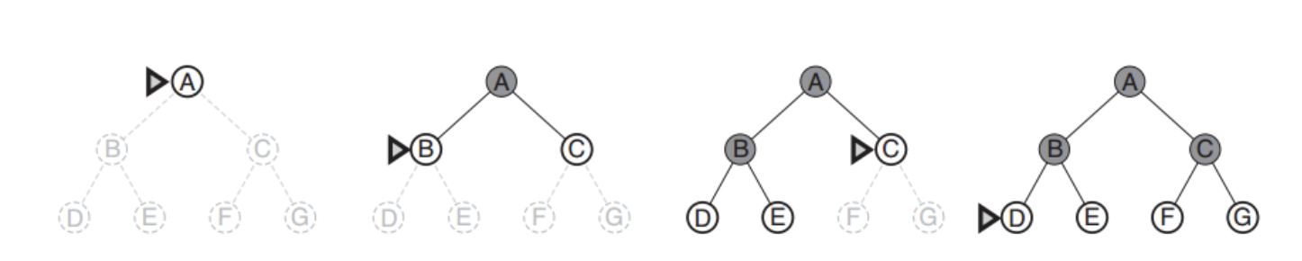
BFS
Notes:
BFS: Both time and space: On expand: O( b^d), On generate O(b^(d+1))
b+b^2+...b^d = O(b^d)
等比数列求和公式 Geometric progression official
a1+a1q+... (n items) = a(1-q^n)/(1-q)
Uniform-cost search
Dijikstra
Fringe (frontier): nodes to expand
If you're performing a tree (or graph) search, then the set of all nodes at the end of all visited paths is called the fringe, frontier or border.

Slide 24
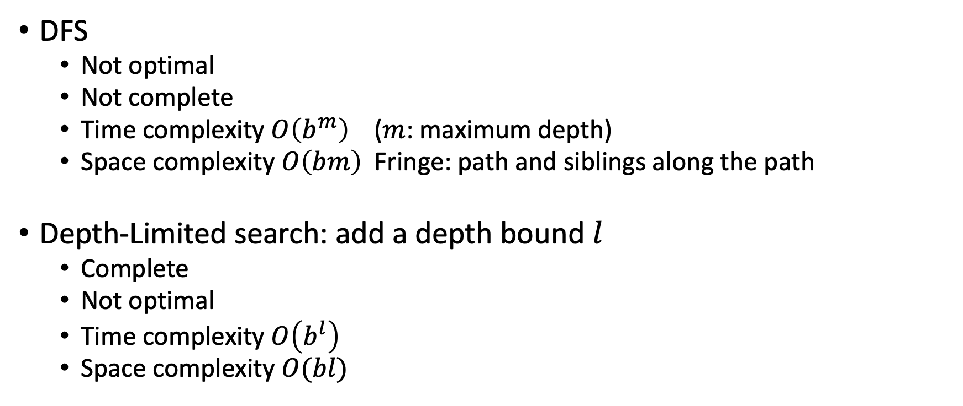
DFS and Depth-Limited Search
DFS
Not optimal
Not complete
Time complexity $O\left(b^{m}\right)$ ($m$: maximum depth)
Space complexity $O\left(bm\right)$ Fringe: path and siblings along the path
Depth-Limited search: add a depth bound $l$
Complete
Not optimal
Time complexity $O\left(b^{l}\right)$
Space complexity $O(bl)$
Notes:
Ask about the limit in depth limited search
m itself can be much larger than d (the depth of the shallowest solution) and is infinite if the tree is unbounded.
there is no advantage, but a depth-first tree search needs to store only a single path from the root to a leaf node, along with the remaining unexpanded sibling nodes for each node on the path. Once a node has been expanded, it can be removed from memory as soon as all its descendants have been fully explored.

Slide 25
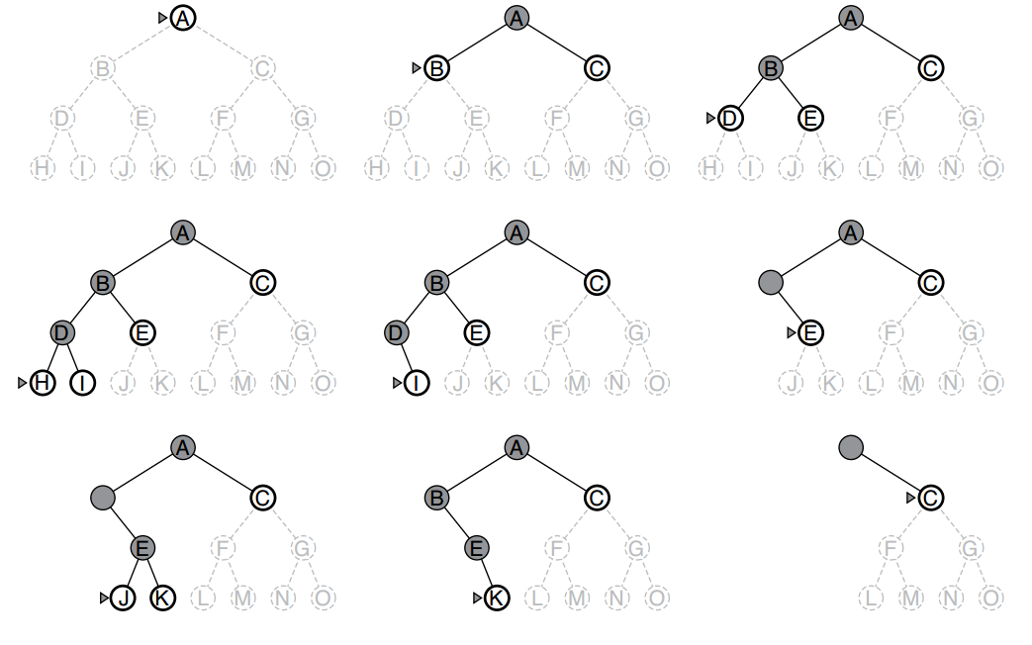
DFS

Slide 26
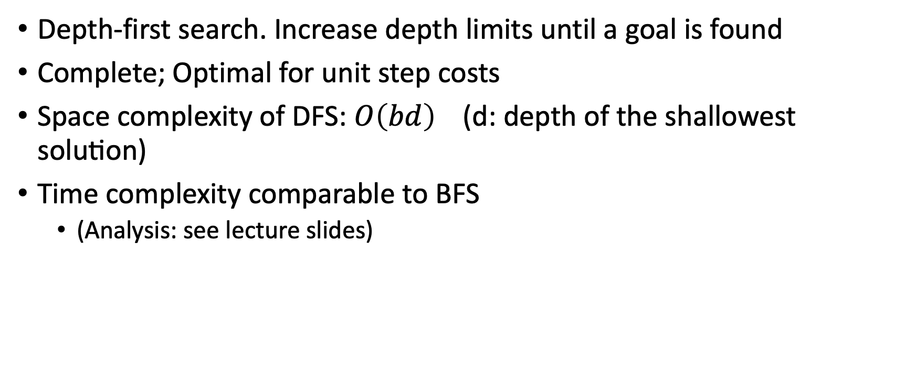
Iterative Deepening Search
Depth-first search. Increase depth limits until a goal is found
Complete; Optimal for unit step costs
Space complexity of DFS: $O\left(bd\right) \text{(}\text{d}\text{: }\text{depth} \text{of} \text{the} \text{shallowest} \text{solution}\text{)}$
Time complexity comparable to BFS
(Analysis: see lecture slides)

Slide 27
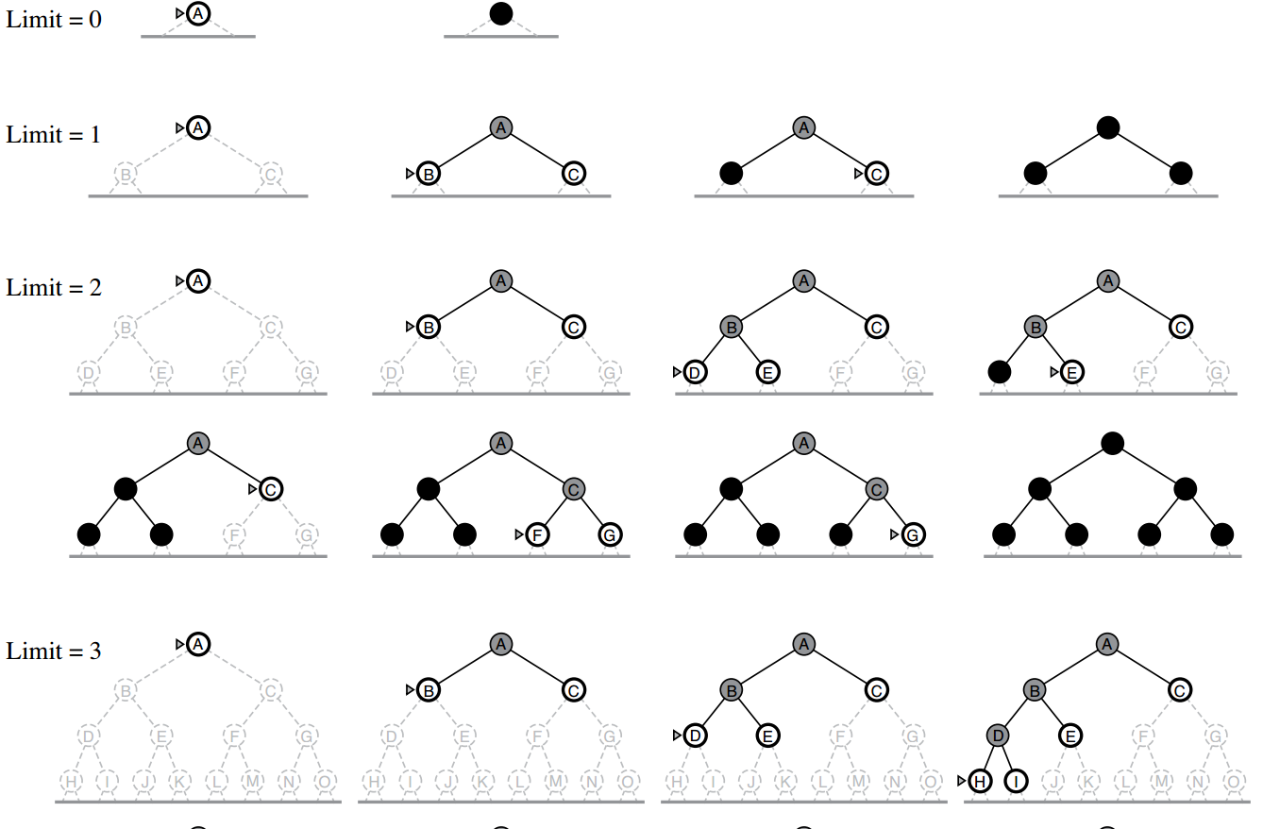
Iterative Deepening

Slide 28
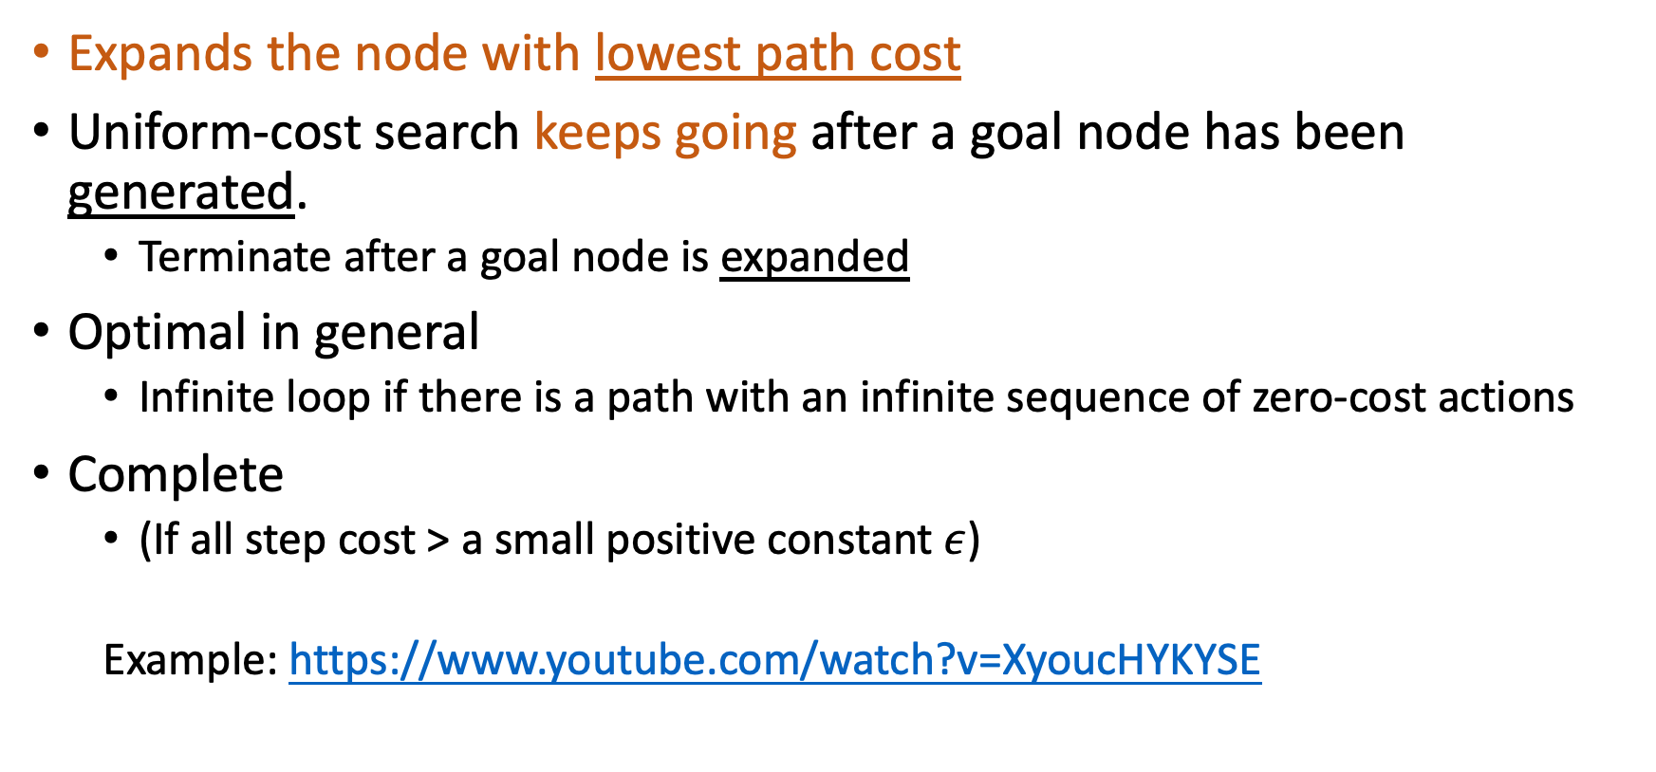
Uniform-cost Search
Expands the node with lowest path cost
Uniform-cost search keeps going after a goal node has been generated.
Terminate after a goal node is expanded
Optimal in general
Infinite loop if there is a path with an infinite sequence of zero-cost actions
Complete
(If all step cost > a small positive constant $ε$)
Example: https://www.youtube.com/watch?v=XyoucHYKYSE
Notes:
$ε:$ epsilon
BFS stops
Uniform-cost search keeps going after a goal node has been generated.
When all step costs are equal, Uniform-cost search is similar to BFS. The difference is that BFS stops as soon as it generates a goal, but UCS examines all the nodes at the goal's depth to see if one has a lower cost. So it generates one more layer.

Slide 29
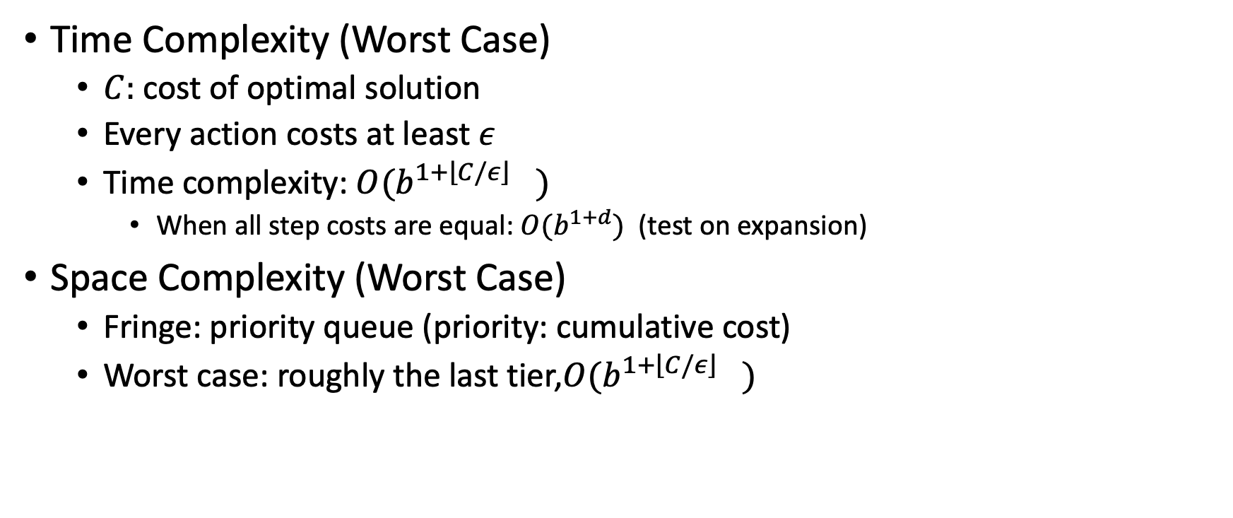
Uniform-Cost Search
Time Complexity (Worst Case)
$C:$ cost of optimal solution
Every action costs at least $ε$
Time complexity: $O(b^{1+\left\lfloor C/\right.ε\left\rfloor \right.})$
When all step costs are equal: $O(b^{1+d})$ (test on expansion)
Space Complexity (Worst Case)
Fringe: priority queue (priority: cumulative cost)
Worst case: roughly the last tier,$O(b^{1+\left\lfloor C/\right.ε\left\rfloor \right.})$
Notes:
O(1+C*/epsilon)

Slide 30
Uniform-Cost Search
Uniform-cost search and BFS
BFS stops after a goal node is generated (unless otherwise specified)
Uniform-cost search keeps going after a goal node has been generated
Notes:
$ε:$ epsilon
BFS stops
Uniform-cost search keeps going after a goal node has been generated.
When all step costs are equal, Uniform-cost search is similar to BFS. The difference is that BFS stops as soon as it generates a goal, but UCS examines all the nodes at the goal's depth to see if one has a lower cost. So it generates one more layer.

Slide 31
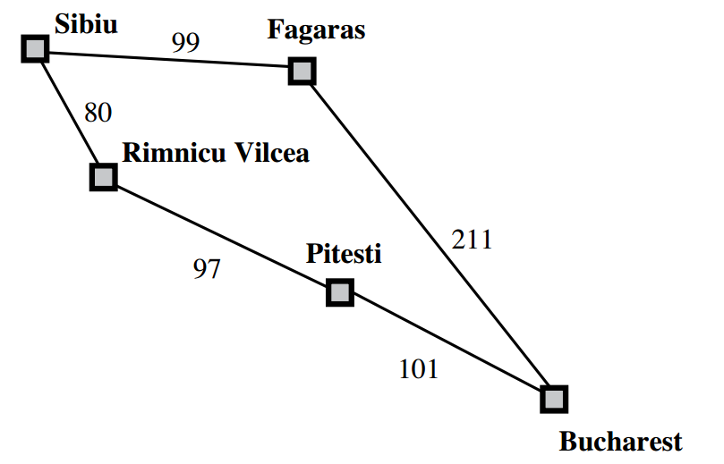
Uniform-Cost Search - Example

Slide 32
Bidirectional Search
Run two simultaneous searches (BFS/Iterative Deepening)
One forward from the initial state
The other backward from the goal
Replacing Goal test: Check whether the frontiers of the two searches intersect
The first found solution may not be optimal
Additional search is required to make sure there isn't short-cut across the gap! (Will show later)

Slide 33
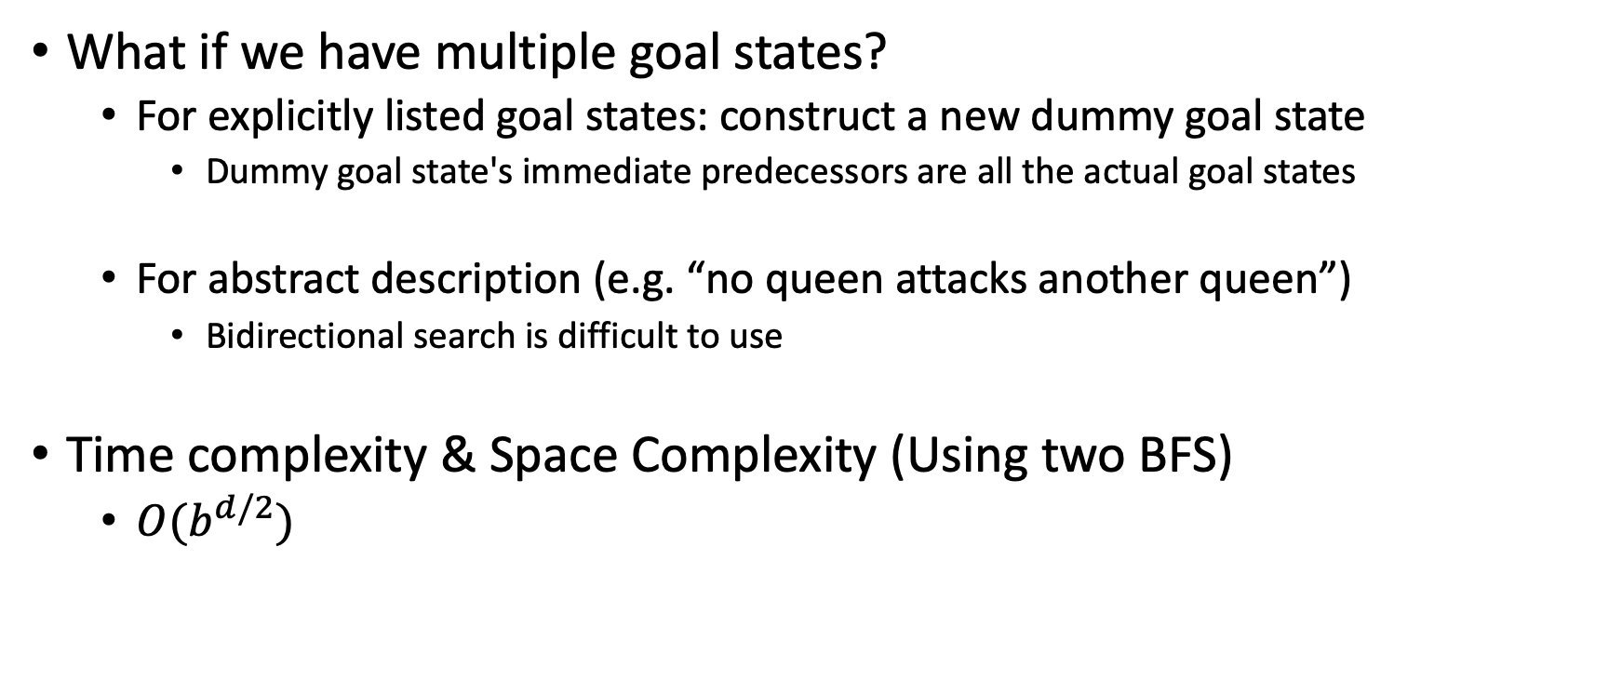
Bidirectional Search (cont'd)
What if we have multiple goal states?
For explicitly listed goal states: construct a new dummy goal state
Dummy goal state's immediate predecessors are all the actual goal states
For abstract description (e.g. “no queen attacks another queen”)
Bidirectional search is difficult to use
Time complexity & Space Complexity (Using two BFS)
$O(b^{d/2})$

Slide 34
Exercise - Word Ladder
Input:
beginWord
endWord (endWord != beginWord)
A dictionary
Transformation:
wordA -> wordB (e.g. "hit"-> "hot")
Only one letter can be changed at a time.
wordB must be in dictionary
Question:
Transform beginWord to endWord
How many transformations we need at least?
Return -1 if no such sequence
How do you solve it?
Notes:
Note:
Return 0 if there is no such transformation sequence.
All words have the same length.
All words contain only lowercase alphabetic characters.
You may assume no duplicates in the word list.
You may assume beginWord and endWord are non-empty and are not the same.

Slide 35
Exercise – Word Ladder
Example
beginWord = "hit"
endWord = "cog",
dictionary = ["hot","dot","dog","lot","log","cog"]
Output: 4
"hit" -> "hot" -> "dot" -> "dog" -> "cog"
https://leetcode.com/problems/word-ladder/

Slide 36
Bidirectional Search (cont'd)
We mentioned
The first found solution may not be optimal
Additional search is required to make sure there isn't short-cut across the gap!
When does this happen?
What if "hot" and "log" are connected in the word ladder example?
"hit" -> "hot" -> "dot" -> "dog" -> ”log"
"hit" -> "hot" -> ”lot" -> “log"

Slide 37
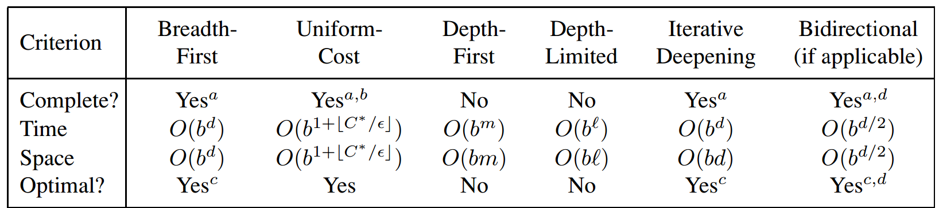
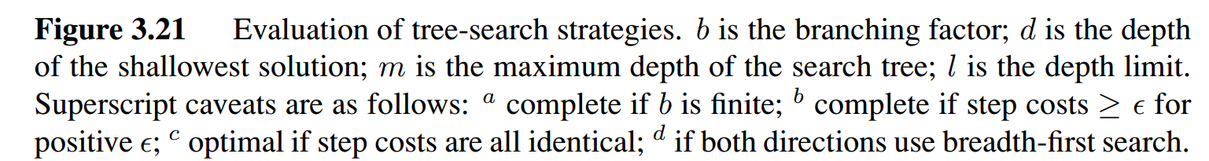
Comparison

Slide 38
How to deal with repeated states? (Regarding the last discussed topic of Discussion Section)
Check your parents (The current path from root to frontier)
Check your ancestors (The current path from root to frontier)
Check every node visited already (All previous search history in other branches)
1 is not always correct (only when states are Markovian)
2 is correct, and can be done recursively
3 is usually incorrect

